Slide 1


The National Rehabilitation Association and the
Pennsylvania Rehabilitation Association
2-13-19

Slide 2
National Rehabilitation Association
Immediately after Congress passed the National Rehabilitation Act of 1920, the National Rehabilitation Association (NRA) began its commitment to persons with disabilities.
The oldest, strongest and most recognized advocacy organization representing rehabilitation professionals in the USA.
Join NRA and automatically become a member of the Pennsylvania Rehabilitation Association.

Slide 3
NRA Purpose
Our Purpose
To promote the development of best practices in the delivery of rehabilitation services to people with disabilities;
To educate our community about disability;
To advocate for the public policy to support full inclusion of people with disabilities in our society;
To encourage and foster recruitment, professional growth, and retention of qualified, competent, dedicated personnel in the field of rehabilitation.

Slide 4
NRA Mission
Our Mission
To provide exemplary leadership through social advocacy and legislation, advance cultural awareness and competence across communities, promote excellence in research and practice, and support professionals engaged in the employment and independence of individuals with disabilities.

Slide 5
NRA Vision & Values
Our Vision and Values
The NRA is committed to advancing the professional practices of rehabilitation driven by culturally-competent, ethical, evidence-based and accountable practices so that individuals with disabilities would be regarded and valued as full members of our society. These individuals deserve equal access, expression of choice, and security of freedom within our communities when engaging in all aspects of life.

Slide 6
NRA
Members include professionals who advocate for programs and services for people with disabilities:
Rehabilitation counselors & administrators
University professors
Job trainers & placement specialists
University students studying rehabilitation programming
Rehabilitation consultants
Physical therapists
Speech therapists
Occupational therapists
Independent living instructors
Allied Professionals

Slide 7
NRA Divisions
NRA Professional Divisions
National Association for Independent Living (NAIL)
National Association of Multicultural Rehabilitation Concerns (NAMRC)
National Association of Service Providers in Private Rehabilitation (NASPPR).
National Association of Rehabilitation Leadership (NARL).
Job Placement and Development (JPD).
Vocational Evaluation & Work Adjustment Association (VEWAA)
Rehabilitation Counselors and Educators Association (RCEA)
Association of Rehabilitation Technicians & Specialists (ARTS)
Rehabilitation Program Evaluation Network (RPEN)
Transition Specialists Division
National Rehabilitation Counselors Association

Slide 8

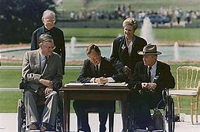
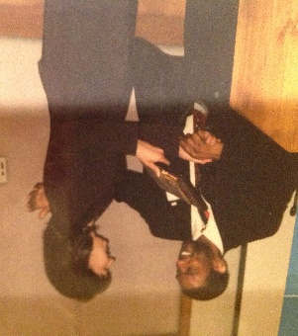
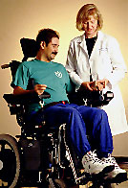
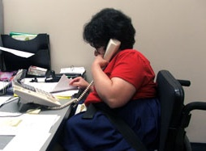
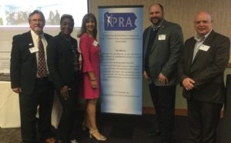

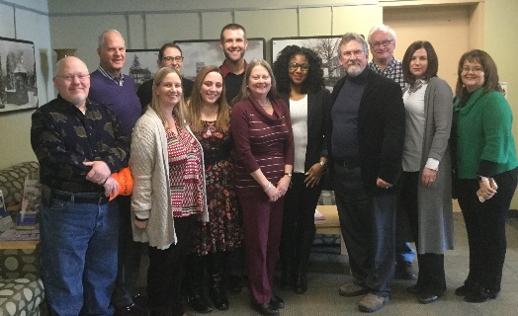
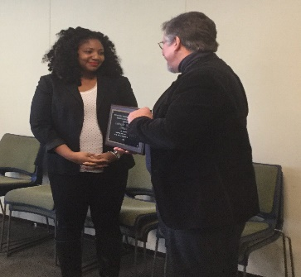


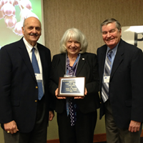
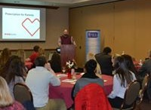
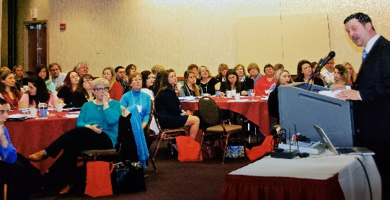

Pictures Related to PRA and Disabilities (See alt text)

Slide 9

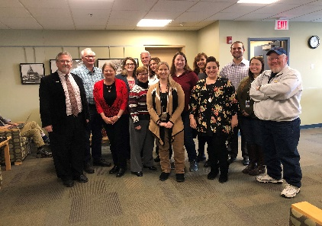
Pennsylvania Rehabilitation Association
Chapter of the National Rehabilitation Association, a private, non-profit organization dedicated to improving the quality of life for all persons with disabilities.
Promoting ethical and state of the art practice in rehabilitation
www.parehab.org

Slide 10
PRA Vision
Vision Statement:
To be the premier organization of diverse professionals committed to the empowerment of all people with disabilities.
Chartered in 1952, PRA continues to promote issues that enable persons with disabilities to participate in the mainstream of society and to….
provide opportunities for professional development for persons in the field of rehabilitation and independent living.
Charles L. Eby
Cecelia Jacobs
Mary E. Switzer

Slide 11
PRA Celebrates
2002 NRA Chapter of the Year!
Hosted 2004 NRA National Conference in Philadelphia
“Rehabilitation: Securing the Blessings of Liberty for ALL”
Celebrating 66 Years of Service in 2018!

Slide 12
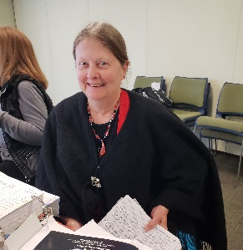

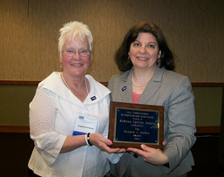

Benefits of PRA Membership
Professional Development and Education
Legislative Advocacy
Annual Training Conference & Exhibits
NRA Division Membership Options
Certified Rehabilitation Certification (CRC) Credits
NRA, NRA Mid-Atlantic Region and PRA Award Recognition
Career Enhancement & Resume Builder
Students get a GREAT Membership Rate!
Networking with Other Professionals

Slide 13
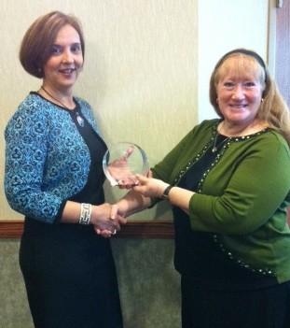
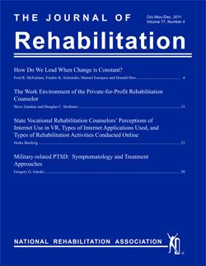
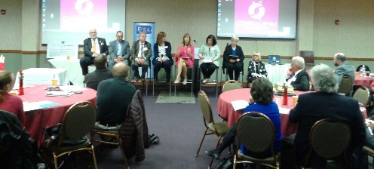
More Benefits of PRA Membership
Professional Advocacy
Motivating, Inspiring, Energizing
Being Part of the BIG Picture
Job Opportunities
Mentoring Opportunities
Feeling of Belonging
Journal of Rehabilitation & Contemporary Rehab
Eligibility for the NRA MasterCard
Eligibility for Professional Liability Insurance, Life Insurance, and Health Care through NRA

Slide 14
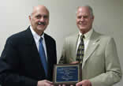
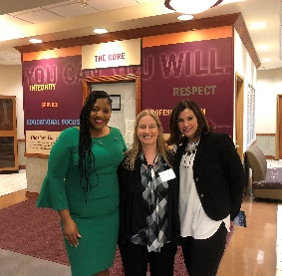
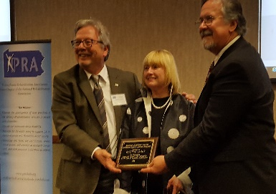
Leadership Development
The PRA strives to advance professional best practices of rehabilitation to its membership, allied professionals, and the community at large. PRA advocates for public policy to support full inclusion of people with disabilities and fosters the recruitment, professional growth, and retention of qualified, competent, dedicated rehabilitation personnel.
These goals are achieved through educational events such as PRA’s annual Professional Development Institute, our website, social media blasts, and networking with state and federal legislators, the business community, and public/private sector rehabilitation organizations.
Targeted strategies are highlighted by legislative updates and the Dr. Ralph N. Pacinelli Policy Forum. PRA’s award program formally recognizes rehabilitation professionals exemplifying extraordinary leadership in counseling, administration, education, employment, and advocacy.

Slide 15
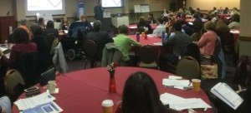
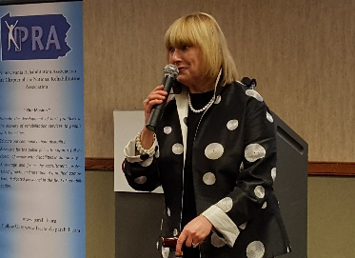
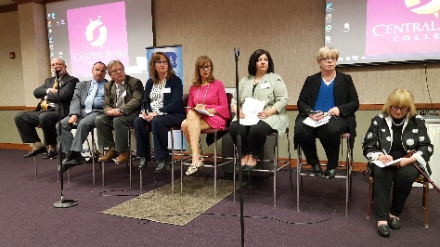
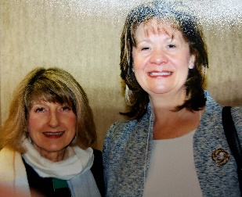
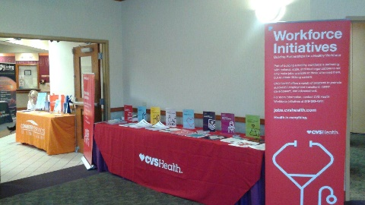
PRA Professional Development Institute
PRA’s premiere educational and networking event
National, state and local experts addressing cutting edge rehabilitation issues and employment strategies
Leadership development - Dr. Ralph Pacinelli Leadership Forum
Town Meeting
Legislative action updates
Networking with public and private sector colleagues
Recognition of outstanding rehabilitation professionals and students
Student poster presentations and mentoring
Vendor and agency exhibitors

Slide 16
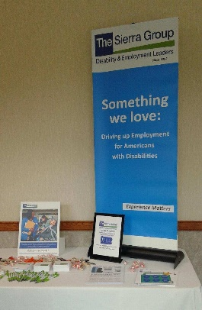
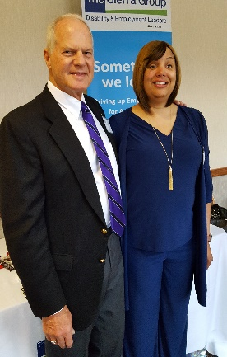

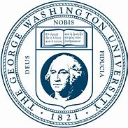

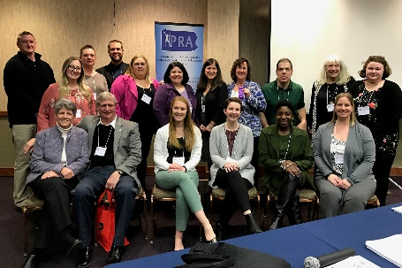



Student Mentoring and Recognition
Student Posters and Presentations
Mentoring
Leadership Development
Award Recognition
Roger Barton Scholarships
Clarion University
George Washington University
Pennsylvania State University
University of Scranton

Slide 17
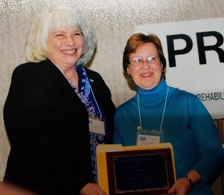
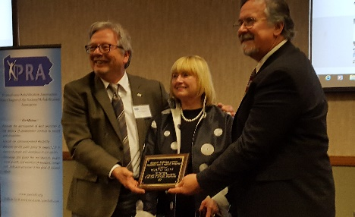
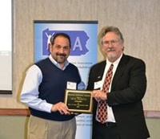
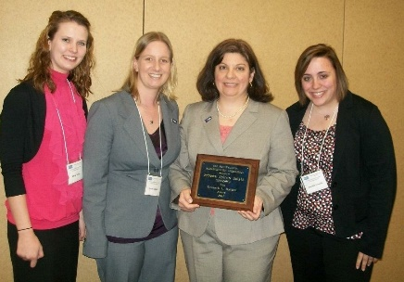
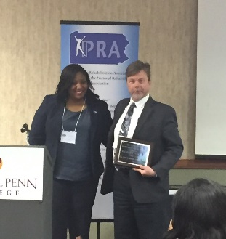
PRA Awards
Kenneth W. Hylbert Award
PRA Distinguished Service Award – (Affirmative Action)
Charles L. Eby Awards
  Charles L. Eby Administration Award
  Charles L. Eby Counseling Award for Independence
  Charles L. Eby Counseling Award for Placement
PRA Organization Award
Lloyd O. Grove Meritorious Service Award
Pennsylvania Rehabilitation Association Philadelphia Founders Award
Cecilia E. Jacobs Distinguished Service Award
Mary E. Switzer Award
Mark M. Walter Humanitarian Award
Ralph N. Pacinelli Leadership Award
PRA Business Award

Slide 18
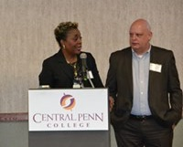
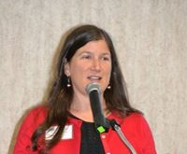
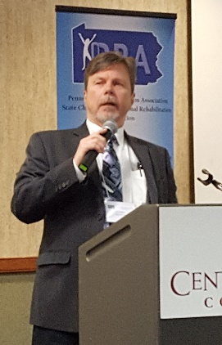
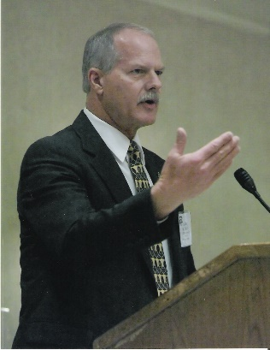
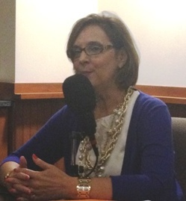
PRA Speakers Bureau
Our knowledgeable members & associates are available to share their expertise on a variety of topics pertaining to the field of rehabilitation:
Professional Development
Disability Issues
Employment
Legislative
Accessing Services
Assistive Technology
Advocacy

Slide 19
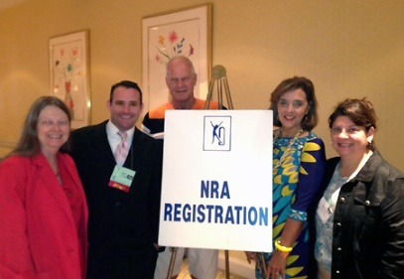
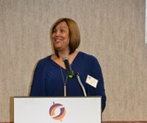

From information-packed educational programs and powerful government advocacy to discount insurance, your NRA/PRA membership will keep you informed, involved and in focus.

Slide 20
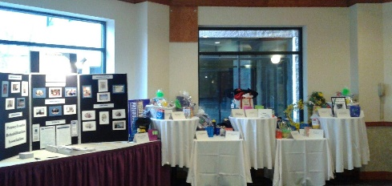
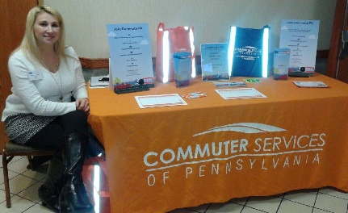
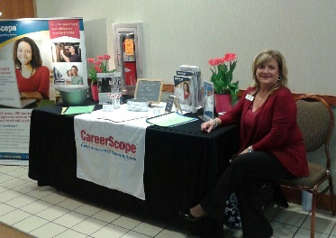


Why not join today?
PRA Website - http://www.parehab.org
NRA Website - http://www.nationalrehab.org

